Slide 1
Software Engineering Assignment 00
<p> About Git</p>

Slide 2
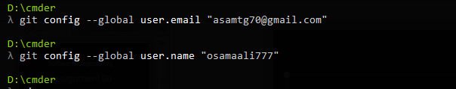
git config --global user.email "asamtg70@gmail.com"
git config --global user.name "osamaali777"

Slide 3
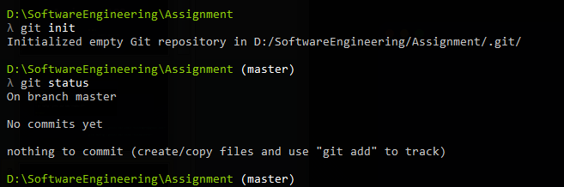
git init
git status

Slide 4
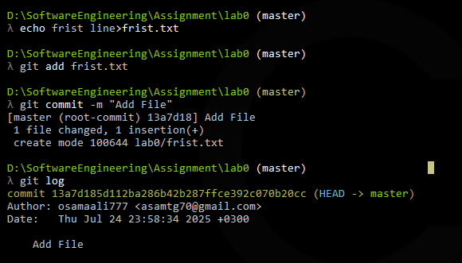
git add first.txt
git commit –m “ Add First”

Slide 5
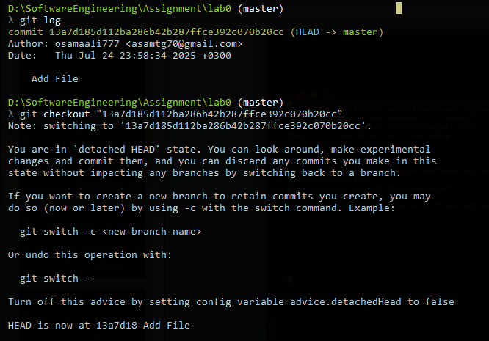
git log
git checkout "13a7d185d112ba286b42b287ffce392c070b20cc"

Slide 6
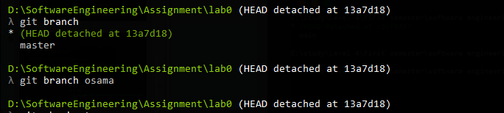
git branch
git branch osama

Slide 7
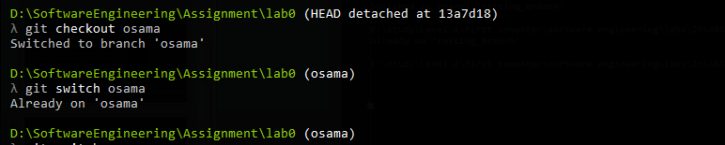
git checkout osama
git switch osama

Slide 8
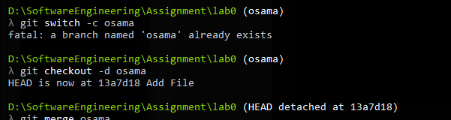
git checkout –d osama
git switch –c osama

Slide 9
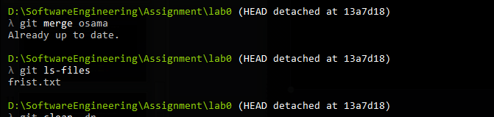
git merge osama
git ls-files

Slide 10
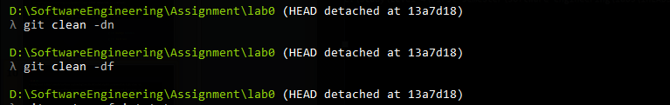
git clean -dn
git clean -df

Slide 11
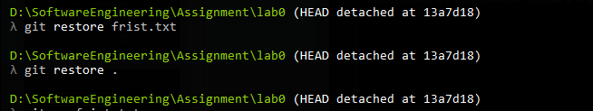
git restore first.txt
git restore .

Slide 12
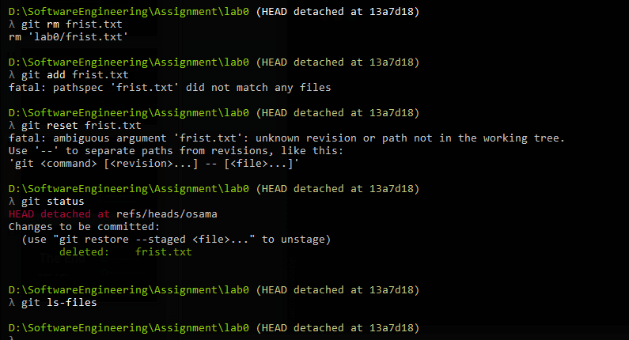
git rm first.txt
git reset first.txt

Slide 13

The End
asamtg70@gmail.com
By:Osama Hashed
https://github.com/osamaali777/SoftwareEngineering

